Slide 1



TOPIC: Open Source Data Visualization.
Submitted by Tribe K:
1) Barsha Behera
2) Poornima Biradar
3) Shruti Pade
4) Abhishek Bhimshenreddy 5) Ritishkumar

Slide 2
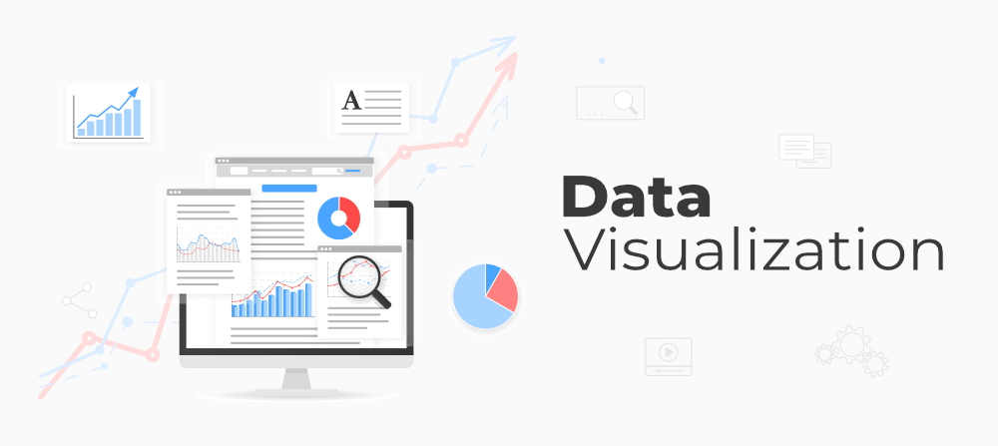

Slide 3
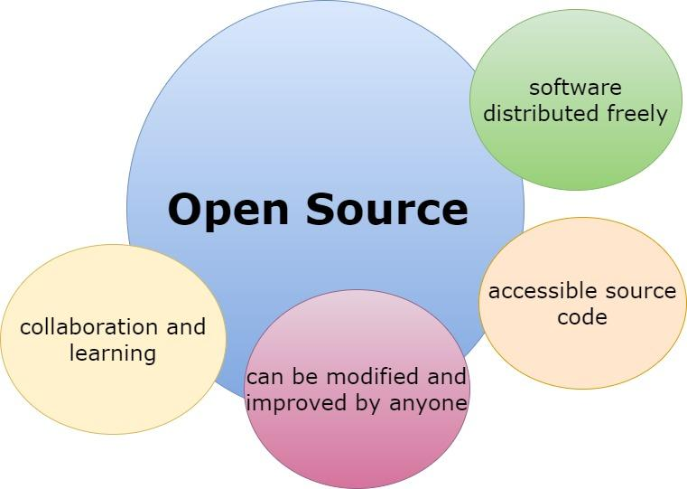

Slide 4
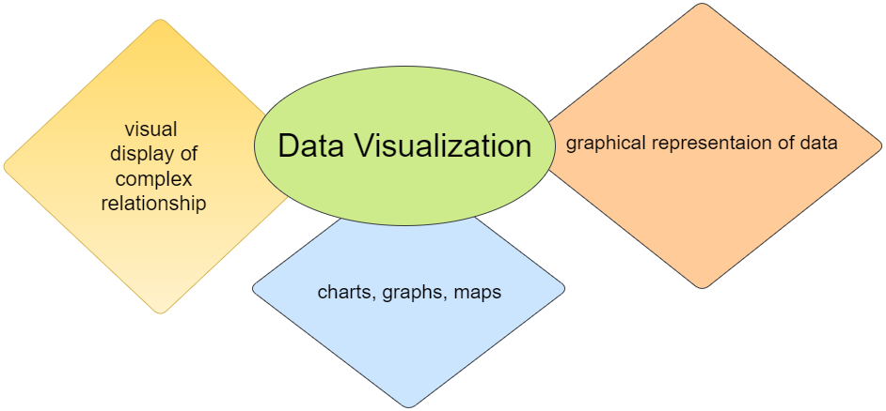
What is data visualization?

Slide 5
What is data visualization:
Data visualization is the graphical representation of information and data in a pictorial or graphical format(Example: charts, graphs, and maps). Data visualization tools provide an accessible way to see and understand trends, patterns in data, and outliers. Data visualization tools and technologies are essential to analyzing massive amounts of information and making data-driven decisions. The concept of using pictures is to understand data that has been used for centuries. General types of data visualization are Charts, Tables, Graphs, Maps, Dashboards.

Slide 6
Purpose of data visualization:
The purpose of data visualization is pretty clear. It is to make sense of the data and use the information for the organization’s benefits. That said, data is complicated, and it gains more value as and when it gets visualized. Without visualization, it is challenging to quickly communicate the data findings and identify patterns to pull insights and interact with the data seamlessly.
Data scientists may find patterns or errors without visualization. However, it is crucial to communicate data findings and identify critical information from them. And for this, interactive data visualization tools make all the difference.

Slide 7
Problem statement:
There are four main scenarios where data visualizations can hinder–not help–your users.
You don’t understand the type of data you need to display
You understand the data, but not how to display it
You’re overwhelming users with too much data or information
A user understands the data but not how to apply it

Slide 8
Why data visualization:
1. Better Agreement
2. A Superior Method
3. Simple Sharing of Data
4. Deals Investigation
5. Discovering Relations Between Occasions
6. Investigating Openings and Patterns

Slide 9



How it works:
imports a file into a tool Eg: .csv, excel etc
Validate the file format and data set
Generate the appropriate graph

Slide 10
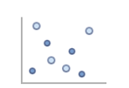
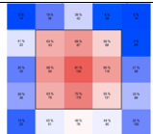
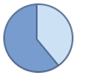
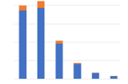
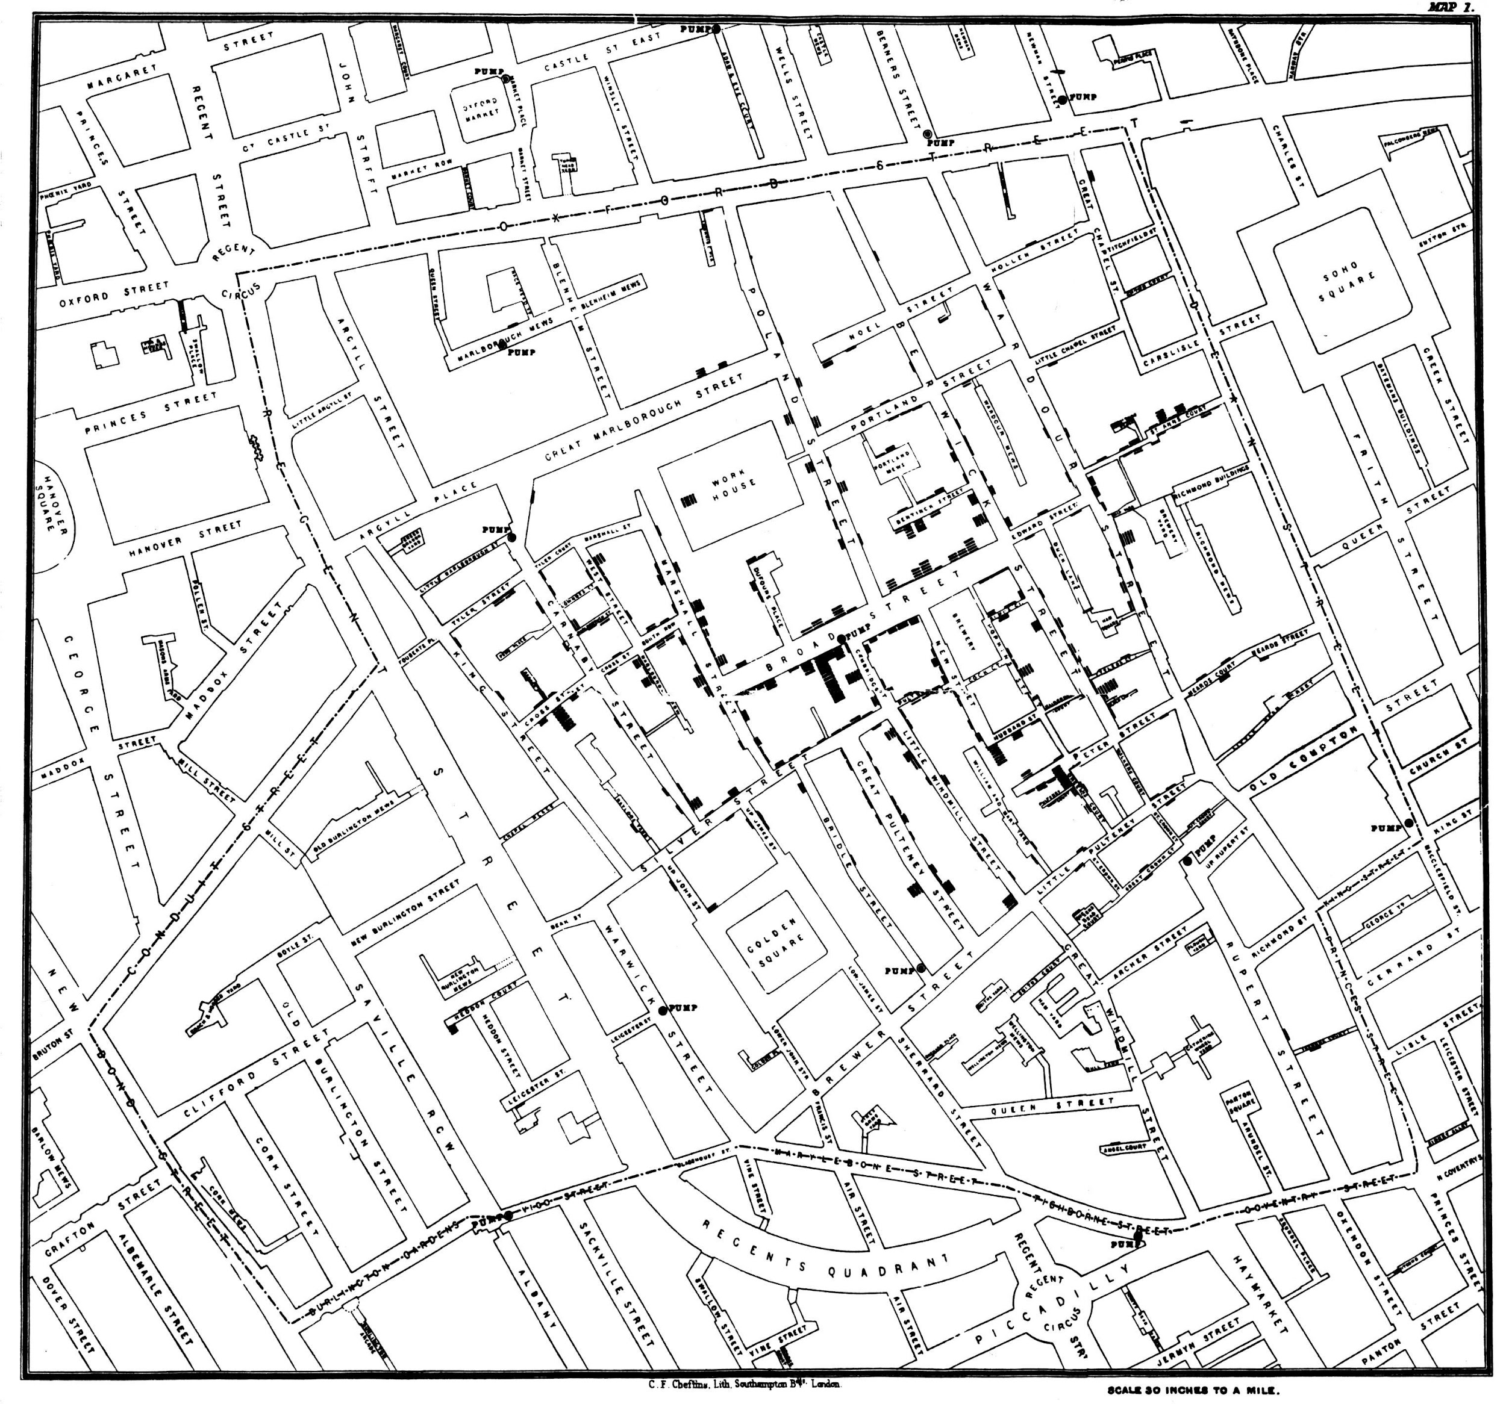

Types of data visualization:
Stacked bar graphs
Scatter plots
Heat maps
Pie Chart
Map
Table

Slide 11
Some specific methods of data visualization:
Historograms
Heat Maps
Tree Maps
Correlation Matrices
Wedge stack Graphs
Scatter Plot
Pie Chart

Slide 12


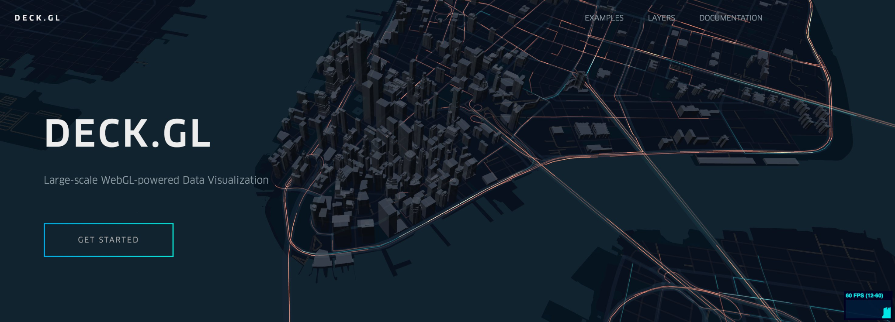

Open source data visualization tools:
ECharts
D3.js
Vega
deck.gl

Slide 13
Open source data visualization tools:
Open source libraries provide a way for analysts to present data in an interactive way.
D3.js: It is a javascript library producing dynamic, interactive visualization in web browsers
ECharts: A charting library which offers an easy way to add highly interactive and customizable charts.
Vega: Provides support to customize visualization across large dataset which are accessible from web.
Deck.gl: A framework, which is used for exploratory data.

Slide 14
Software requirements:
OS: Windows
IDE: jupyter notebook
Programming language: Python

Slide 15
Conclusion:
Data visualization helps tell stories by curating data into a format that is easy to understand, highlighting trends, and illuminating outliers. However, it is not as easy as dressing up a graph to make it look better or slapping on the “info” part of an infographic. Effective data visualization is a delicate balancing act between form and function.

